Slide 1
Content Development
WP2 T3

Slide 2



Learning Objectives
Recognize the most important Markdown syntax elements
Develop new learning materials from scratch by applying the Markdown syntax on existing template documents
Manipulate existing learning objects, making them compliant with the FAIR-by-Design methodology

Slide 3
Agenda
Introduction to Markdown Elements
Markdown in Practice
Editing Existing Markdown Documents

Slide 4

Introduction
Simple syntax to accomplish common text formatting tasks
Headings
(Un)ordered lists
Links
Images
Tables
Bold/Italic text
Metadata
Optional WYSIWYG editors
Image by bodobe from Pixabay

Slide 5
Markdown Overview
Two approaches
Native Markdown syntax
Obsidian WYSIWYG editing toolbar plugin
Rendering is determined by the Markdown flavor
No 100% interoperability between Obsidian and MkDocs
We will solve issues along the way…
Export to various final output formats possible
PDF
HTML

Slide 6
Let’s get started…
Markdown syntax

Slide 7
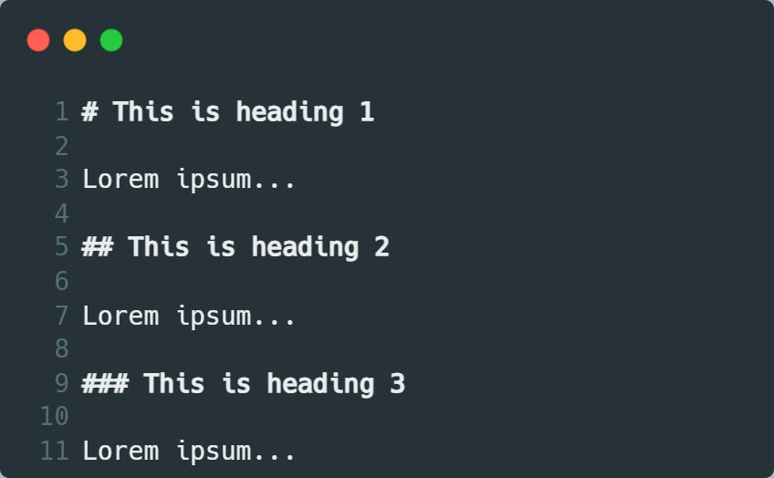
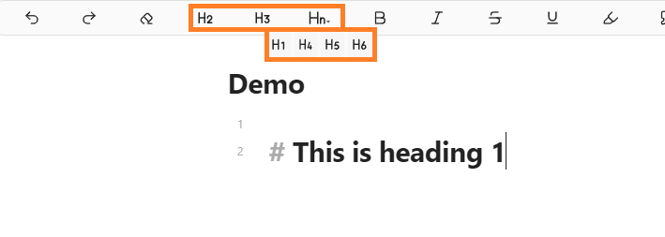
Headings
‘#’ prefix
Multiple levels possible
# - Heading 1
## - Heading 2
…

Slide 8
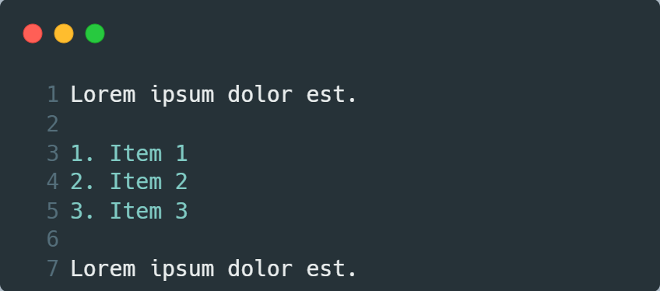
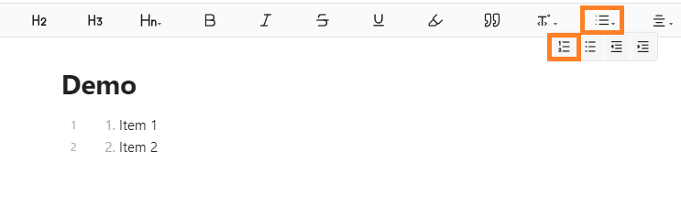
Ordered Lists
Intuitive
Simply prefix with the desired number
Empty line before and after

Slide 9
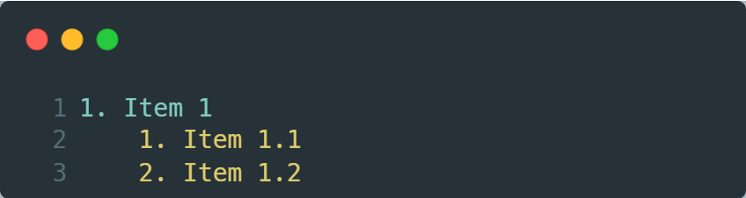
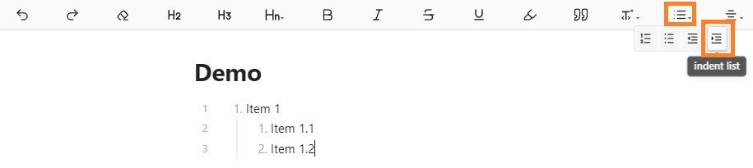
Nested Ordered Lists
As regular lists, but indented (prefixed with spaces)
Important to keep the indentation consistent
Obsidian’s editing toolbar takes care of the indentation, if used

Slide 10
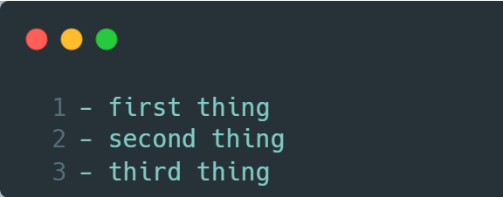
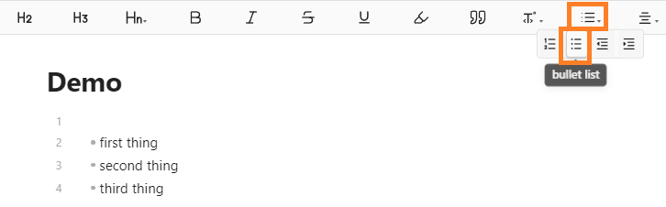
Unordered Lists (Bullets)
Two equivalent approaches
- prefix
* prefix
Decide which one to use and stick to it

Slide 11
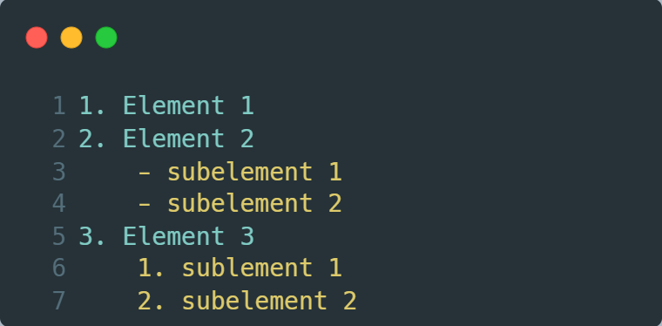
Nesting Ordered and Unordered Lists
Interchangeable nesting between ordered and unordered lists
As previously, indentation is important
When using the Obsidian toolbar, the same indentation buttons can be used as previously

Slide 12
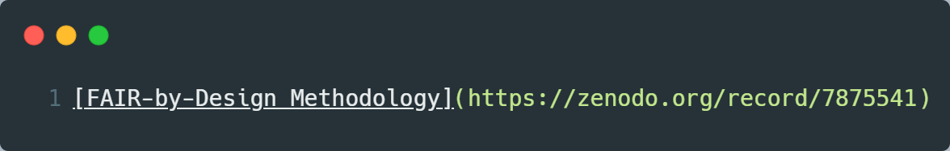
Links
Syntax: [Link Text](https://example.com)
Two parts
Visible text between “[]” brackets
Link location between “()” brackets
When linking to a web page, important to set “http://” or “https://”

Slide 13
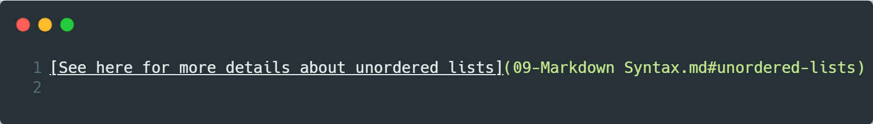
Internal Links to a Page
Relative links to an arbitrary heading on the existing page or a different page
Syntax for he link location part: markdown-file.md#heading
First part: relative path to the markdown file
Second part: “#” sign
Third part: heading name, all lowercase, spaces replaced with “-”
Advanced Linking with Obsidian in the Git book

Slide 14

Images (1)
Similar syntax to the one for inserting links
An additional “!” as a prefix
The text between “[]” is the alt text. Important for accessibility
Obsidian supports automatic image placement using copy/paste
Demo on the next slide

Slide 15
Images (2)
Obsidian image handling demonstration

Slide 16
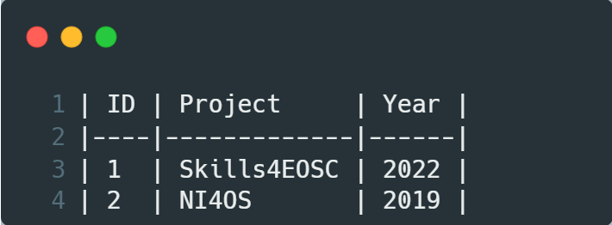
Tables (1)
Somewhat complicated (compared to previous elements)
Let’s start with an example and then analyze it
Header row separated from the body using:
|----|-------------|------|
Number of dashes is not important (only cosmetic)

Slide 17
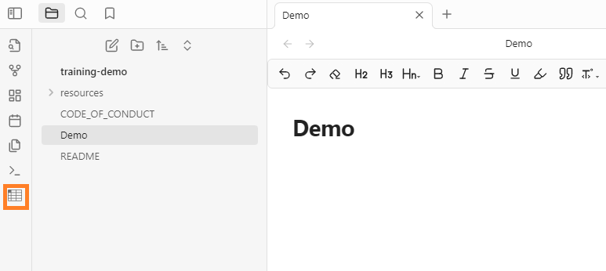
Tables (2)
Simpler approach to creating tables in Obsidian using a plugin
Dedicated button after installing “Markdown Table Editor”

Slide 18
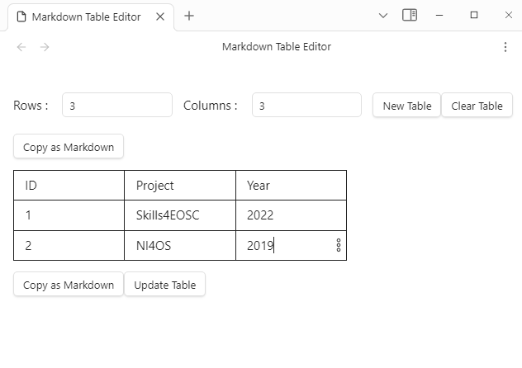
Tables (3)
Depending on context:
An existing table is selected -> the plugin launches in editing mode
No table is selected -> creating a new one and launching editing mode

Slide 19
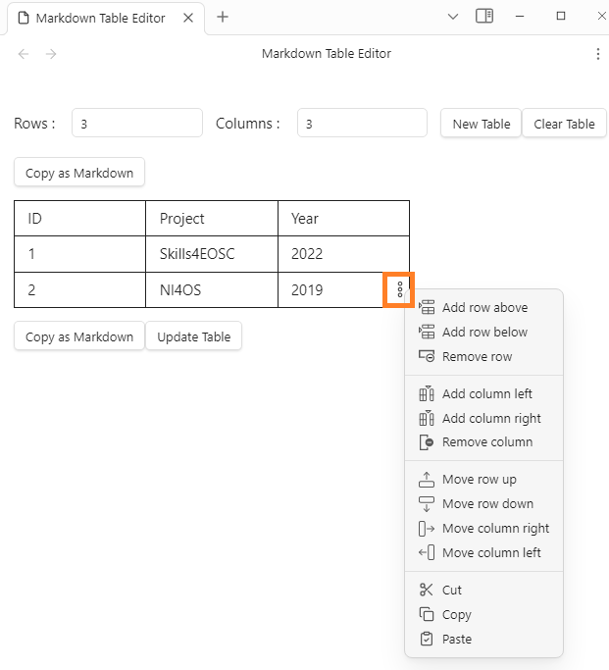
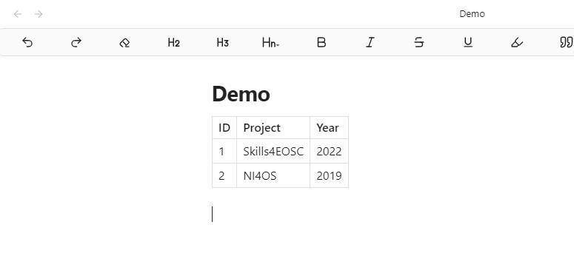
Tables (4)
Advanced operations supported
Adding/Removing rows
Moving rows

Slide 20
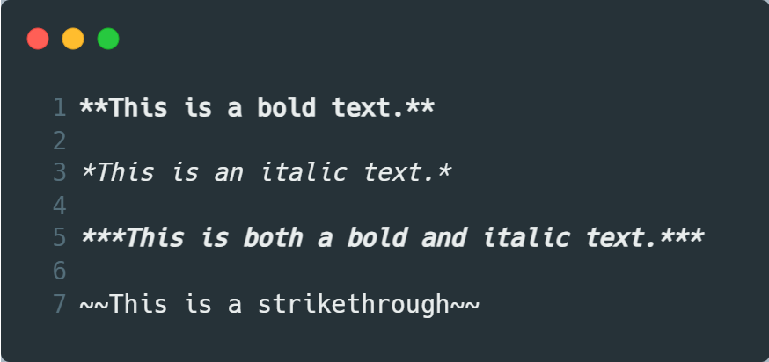
Various Text Formatting Operations
Bold, italic, underline, and various combinations
Dedicated buttons in the editing toolbar
Changing text color and background should be avoided (possible incompatibility between Markdown flavors)

Slide 21
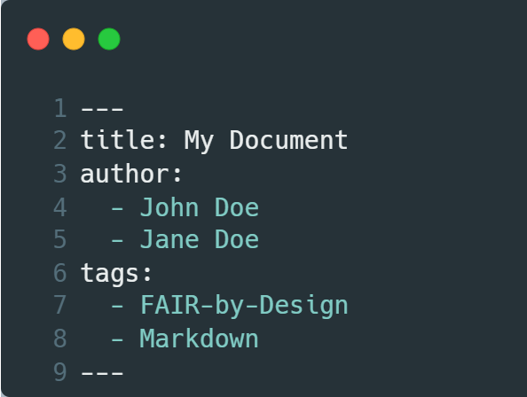
Metadata
Arbitrary metadata added to the very top of the file
Dedicated section enclosed with “---” lines
Special treatment for some parameters (but not all)
Title – sets the page title in the Git book
Tags – added as pill-shaped boxes at the top of the page
YAML syntax (indentation is important)

Slide 22
Taking Markdown for a Test Drive
Using the obtained knowledge regarding Markdown, fill out the lesson plan template with the necessary information.

Slide 23
First Things First…
Make sure that the cloned repository is up-to-date and that any remote changes have been pulled locally.

Slide 24
The Road Ahead
Make a copy of the template_unit_lesson_plan.md template
Open it in Obsidian
Fill out the metadata
Change heading 1 to the title of the unit
Change heading 2 to “Goals”, add an unordered list with at least 3 elements
Edit the unordered list in the “Location” section
Format estimated training duration in the “Total Duration” section as both bold and italic
Provide number of attendees
Convert the unordered list in the “Learning Objectives” section to an ordered list, providing at least 3 learning objectives
Edit the table in the “Plan” section, removing any unneeded rows. Add a link in the “Activities” section.
Provide “Assessment” information, adding a nested list to an existing list element.
Alter the “Certification or Badge” section by inserting an image of an arbitrary badge
Complete the lesson plan by filling out the “Reflections” and “Comments” sections
Commit the changes and push them to GitHub

Slide 25
Thank you! Any questions before we continue?
vojdan.kjorveziroski@finki.ukim.mk
Cite instructions on: https://doi.org/10.5281/zenodo.10014781

